Slide 1
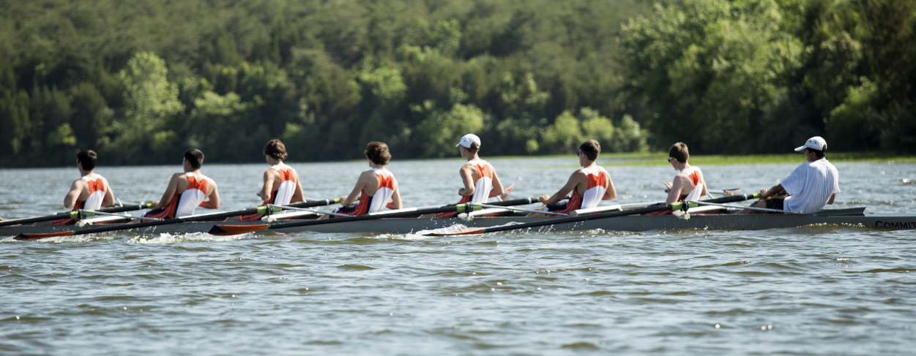
SPRING 2024 PARENT MEETING 2/26/2024

Slide 2
Agenda
Coaches & Leadership for Spring
Key Dates
Regatta Schedule
Open positions and Volunteer Requirements
Spring Fees
EVSRA and Spring Break Training Camp
Additional Items
Boathouse Updates
Questions

Slide 3
Coaches, Captains and Boosters
Coaches
Head - Rich Schafer
Assistant - Jessica Sigalis
Assistant - Scott Walker
Assistant - Cliff Ward
Assistant - Michael Chaisone
Assistant - Kylie Kalik
Boosters Leadership
President – TBD
Operations – Erik Ingle
Treasurer – Anna Kimmel
Communications – Michael Chupeco
Fundraising – Laurissa Skinner
VASRA Member/LOC – Tammie Berger
Spirit Wear – Kim Sheehan
Food – Kim Sheehan
Volunteer Coordinator – OPEN
Travel Coordinator – OPEN
Banquet Chair – Arlie Yruma
Captains
Ryan Berger
Daniel Detling
Vicki Quirk
Skyler Riggio

Slide 4
Key Dates for Spring
Feb 27-Mar 21 Practice at School/Erg Training (4:30pm-6:30pm, M-F)
March 11 Swim Test at Ida Lee (Mandatory)
March 16 Erg-a-thon Fundraiser
March 23 First Regatta, EVSRA* in NC
March 24-29 Spring Training* @ Bob Cooper, Summerton, SC
April 1 Practice at Algonkian Begins (5pm-7pm M-F)
Apr 6-May 11 Occoquan Regattas, every Saturday
May 16-18 Stotesbury Regatta*, Philadelphia
May 29 Awards Banquet
*Additional fees

Slide 5
Regatta Schedule
March 23 EVSRA Season Opener NC (travel regatta*)
April 6 Darrell Winslow Regatta, Occoquan
April 13 Ted Phoenix Regatta, Occoquan
April 20 Ryz Obuchowicz Regatta, Occoquan
April 27 Al Urquia Regatta, Occoquan
May 4 VSRC Day 1 (Lower Boats), Occoquan
May 11 VSRC Day 2 (Upper Boats), Occoquan
May 17-18 Stotesbury Cup Philadelphia (travel regatta*)
May 24 SRAA Nationals (travel regatta*)
* Additional fees collected for travel regattas

Slide 6
Volunteer Requirements and Food Donations
VASRA Volunteer Positions
The team is required to fill 3-5 roles for every VASRA regatta (or we are fined!)
Each family is required to fill at least 1 role during the season
SignUp Genius is posted on our website and QR code here
Food Donations
Snacks, fruit, bagels, etc will be collected for each regatta. A separate Signup Genius will be sent for food donations
For all local regattas, Rowers will pack their lunch or buy from the concession stands

Slide 7
Spring Fees
Crew is 100% self funded - the team gets ZERO funds from county/state.
Annual fees are based on projected team size, coach salaries, equipment needs, and other factors. The goal is to keep fees as low as possible while meeting current and future obligations.
Spring 2024 Team fee: $1425 - paid via check/cash by 3/2/24
Payments made after 3/2/24 = additional $50 Late Fee
All payments are non-refundable, regardless of circumstance.
Additional Costs:
Team Uni: approx $100
EVSRA and Spring Training (package deal): $900
EVSRA (by itself): $250
Spring Training (by itself): $800
Stotesbury Cup: $500 (2 night stay in Philadelphia area)

Slide 8
EVSRA Regatta (Season opener)
& Spring Training
EVSRA Regatta - Elizabeth City, NC
Travel Saturday morning (5:30 AM departure) March 23rd
Regatta March 23rd
Depart from Elizabeth City to Spring Training
NOTE: If not attending Bob Cooper, parent must pick up rower in NC (4 hrs from Ashburn)
Spring Training - Bob Cooper
Located in Summerton, SC on Lake Marion
March 24-29
Incredible value - rowers get a full season of training in one week

Slide 9
Additional Items
US Rowing: Rowers must register with US Rowing and link membership to Briar Woods Crew Club to be eligible to participate in regattas
Fundraising opportunities:
Erg-a-thon
Spirit Wear Gear - PJ pants, beanies, hoodies, etc
Overstock/Vintage sales
Shoe donations
Poinsettia sales
Super Bowl Squares
Looking for Corporate Sponsorships
Summer Camp - Beaver Dam Boathouse July 15-19 and July 22-26

Slide 10
Uniforms and Spirit Wear
Unisuits
Unisuits have been ordered and will be distributed prior to the first regatta.
Uni Fee: $100 payable by check or PayPal tonight.
If you do not submit payment tonight, you will be invoiced through TeamSnap (unless your athlete has already told us their old uni still fits).
Spirit Wear
Spirit Pack: All athletes will receive a spirit pack which includes: a drawstring bag, 2 shirts (long and short), hat, car magnet, keychains, and stickers
Vintage spirit wear for sale tonight
Parent shirts, hats and items will be available for ordering soon - stay tuned!

Slide 11
Crew – What to Wear
What to Wear - In general, the best clothing for rowing is soft, stretchy, breathable, and fairly form-fitting. One of the basic clothing requirements is Spandex shorts/trousers for wearing in the shell. Loose shorts can get caught in the slides under the moving seats, so avoid basketball style shorts, sweatpants, or warm-ups. You should avoid cotton. Cotton does not keep you warm when it gets wet; instead, it makes you colder.
On the Water - Conditions on the water often are 10 degrees cooler, and the wind is frequently stronger than on the land, so the best advice is to wear layers that will do the best job of keeping you warm. You will get wet from perspiration, rain, and splash. The key is to have synthetic clothing that will keep you warm even when wet. The best clothing for rowing is soft, stretchy, breathable, and fairly form-fitting. Loose tops can get caught in the oar handles, so avoid bulky jackets or sweatshirts.
Hands - Hands can get cold while rowing. However, you will not see rowers using traditional cold-weather gloves. The reason for this is that rowing requires a tactile feel of the handle.
Socks - Socks should be synthetic or wool (SmartWool socks are good, for example) to help ensure that feet stay warm while wet. You should have second pair on land. Good socks will help prevent blistering from the hull’s shoes. Change your socks every practice in order to prevent fungus or athlete’s foot.
Shoes - All rowers and coxswains should bring a pair of running shoes to every practice. Even when we are on the water, sometimes water conditions prevent us from taking to the water. In such circumstances, it is not uncommon that the team will run together. This is a perfect use for those ratty old sneakers that are no longer good for jogging. Also, Crocs or Slides are used for taking the boat to the dock.

Slide 12
Crew – Terms
Bow - The forward end of the shell.
Stern - The rear end of the shell.
Port - The left side of the shell when facing the bow. In sweep rowing, the designation of a rower who normally rows with an oar on the port side.
Starboard - The right side of the shell when facing the bow. In sweep rowing, the designation of a rower who normally rows with an oar on the starboard side.
Coxswain (or Cox, or Cox’n) - The person who sits at the stern of the shell (although this may be in the bow of some 4s), steers, gives commands, calls the ratings, and urges the rowers on in a race. A knowledgeable coxswain will generally serve as an “onsite/in-the-shell” assistant to the coach. Usually light in weight, a good coxswain will have as much competitive spirit as the rowers and can make a considerable difference in a race.
The Stroke - The rower sitting nearest the stern (and the coxswain). The stroke is responsible for setting the stroke length and cadence for the rest of the crew, following the commands and encouragement of the coxswain.
Check - Any abrupt deceleration of the shell caused by some uncontrolled motion within the shell; an interruption in the forward motion of the shell. Also used as a command (“check it!”) to stop a shell as fast as possible by jamming the blades into the water as brakes.
Course - A straight racecourse for rowers that normally has 6 lanes. In high school, the course length is 1500 meters, while in college and Olympic events; the course length is 2000 meters.
Cox Box - A small electronic device, which aids the coxswain by amplifying his or her voice, and which gives a readout of important information such as stroke count.
“Way-Enough” - Actually sounds like “way-nuff”. This is the coxswain’s call to have all rowers stop rowing and let the boat come to a stop.
“Row Easy” or “Paddle” - A command to use very light strokes to move the boat through the water at a slow speed. Usually used when approaching a dock.

Slide 13
Crew – Equipment Terms
Oar - The piece of equipment that each rower uses to propel the boat. In sweep rowing, each oar is approximately 12 feet long, lightweight and well designed.
Blade - The wide flat section of the oar at the head of the shaft. The two types of blades are called hatchets and spoons.
Shell - The racing boat. Shells come in configurations and sizes for single rowers, pairs, fours, and eights. An eight is approximately 60 feet long, narrow (about two feet wide at its widest point), and weighs about 280 pounds.
Sweep - A shell configured so that each rower has one oar. Oars on a sweep shell are normally alternated from side to side.
Foot Stretcher - Adjustable brackets in a shell to which the rower’s feet are secured in attached sneakers or similar footwear.
Rigger - The device that connects the oarlock to the shell and is bolted to the body of the shell.
Oarlock - A U-shaped swivel that holds the oar in place. It is mounted at the end of the rigger and rotates around a metal pin.
Slide (or Track) - Two tracks on which the seat moves. The seat moves forward and backward on the slide, enabling the rower to compress his or her body at the start of the stroke and then use the combined power of the legs, back, and arms when actually executing the stroke.
Gunwale - Top section on the sides of a shell hull. The riggers are secured to the gunwale with bolts.
Rudder - Steering device at the stern. The rudder is connected to cables (tiller ropes) that the coxswain uses to steer the shell.
Skeg (or Fin) - A small fin located along the stern section of the hull. This helps to stabilize the shell in holding a true course when rowing. All racing shells have a skeg. The skeg should not be confused with the rudder.
Rigging - The configuration of accessories (riggers, foot stretchers, oars, etc) in and on the shell. Examples of rigging adjustments that can be made are the height of the rigger, location of the foot stretchers, location and height of the oarlocks, location of the button on the oar and the pitch of the blade of the oar.
Slings (or Boat Slings) - Collapsible/portable frames with straps upon which a shell can be placed temporarily.

Slide 14
Boathouse Update

Slide 15
